Slide 1
Digital
Art
Platform
by
Zheng Liu and Jing Jiang

Slide 2
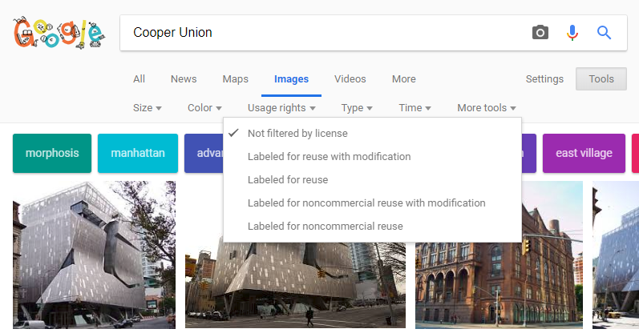
Copyrights in Digital World
Notes:
The copyright issue of digital art
Our focus is on the commercial use for now.
Project not designed to prevent illegal uses.
Hard to protect because no where to trade.
It is to make it easier for who pay attention to copyrights to trade. Increase the knowledge of the public about digital copyrights.

Slide 3
Problems for Now:
Weak knowledge about digital copyright.
2. Hard to keep record of transactions.
3. No proof when there is a dispute.
4, Hard to manage payments
Notes:
Project not designed to prevent illegal uses.
Hard to protect because no where to trade.
It is to make it easier for who pay attention to copyrights to trade. Increase the knowledge of the public about digital copyrights.

Slide 4
Functions:
Buy
Complete transfer of Copyright.
Rent
Right to use in a time period.
Auction
The highest bid buys the copyright.
Quotes for illustration purposes only

Slide 5
We build our project as a smart contract on Ethereum, a blockchain platform.
Decentralized .
Security
Trustless
Seller
Buyer
Dealer
Notes:
Information is not store at a centralized party.
Hard for malicious moves. Ex: change the information.
Low risk of treaty violations. Build trust between users.

Slide 6
How does it work?
Buy/Rent/Bid
Ether as the currency
Smart Contract as the bank
Send Ether to the contract
Y
Met the terms?
Succeed,
Money Transfered
Fail,
Nothing happens

Slide 7
Potential Attacks:
Dishonest users Assumption
Double-spending Nonce
Notes:
Project not designed to prevent illegal uses.
Hard to protect because no where to trade.
It is to make it easier for who pay attention to copyrights to trade. Increase the knowledge of the public about digital copyrights.

Slide 8
Easy:
Contract building
Testing
Setting up environment
Interface
Hard::
Debug
Working with Ganache & Metamask
Front & Back End Interaction

Slide 9
Team Roles:
Jing: management, front end, interface, page design
Zheng: back end, interface, smart contract, background research
Evaluation::
bug-free
Accessibility
Stability
Aesthetics

Slide 10


Github & Acknowledgements
https://github.com/jassiay/Digi-Art-Platform
CryptoKitties
CryptoZombies
Pet shop Truffle box

